Slide 1

AUTOMATED HELMET VIOLATION
20D41A6621 G.SOWMYA
20D41A6639 N.THARUN
20D41A6648 P.RISHITHA
20D41A6628 I.HARSHA VARDHAN
UNDER THE GUIDANCE OF :UMA MAHESWARI (HOD)

Slide 2
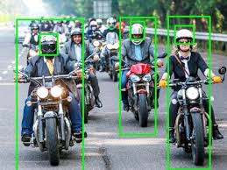
AGENDA
ABSTRACT
INTRODUCTION
SYSTEM ARCHITECTURE
EXISTING SYSTEM
PROPOSED SYSTEM
MODULES
UML DIAGRAMS
ADVANTAGES
SYSTEM REQUIREMENTS
PROJECT INPUT/OUTPUT
FUTURE SCOPE
CONCLUSION

Slide 3
ABSTRACT
In current situation, we come across various problems in traffic regulations in India which can be solved with different ideas. Existing system monitors the traffic violations primarily through CCTV recordings, where the traffic police have to look into the frame where the traffic violation is happening, zoom into the license plate in case rider is not wearing helmet. But this requires lot of manpower and time as the traffic violations frequently and the number of people using motorcycles is increasing day-by-day. What if there is a system, which would automatically look for traffic violation of not wearing helmet while riding motorcycle/moped and if so, would automatically extract the vehicles' license plate number. Recent research have successfully done this work based on CNN, R-CNN, LBP, HoG, HaaR features,etc.

Slide 4
INTRODUCTION
Helmet reduces the chances of skull getting decelerated, hence sets the motion of the head to almost zero. More importantly it acts as a mechanical barrier between head and object to which the rider came into contact Manual surveillance of traffic using CCTV is an existing methodology. Therefore, cites with millions of population having so many vehicles running on the roads cannot afford this inadequate manual method of helmet detection. So here we propose a methodology for full helmet detection and license plate extraction using YOLOv2, YOLOv3 and OCR. Basically helmet detection system involves following steps such as collection of dataset, moving object detection, background subtraction, object classification using neural networks.

Slide 5
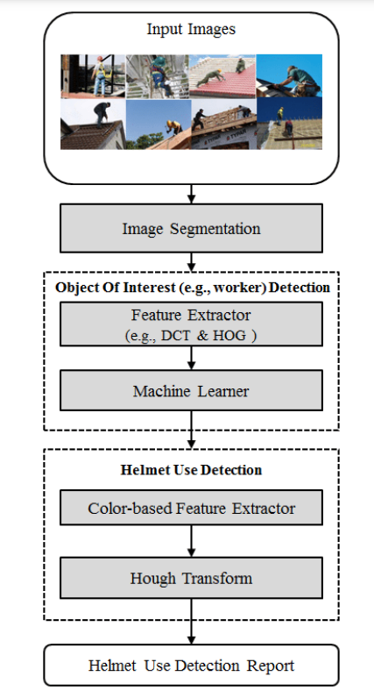
SYSTEM ARCHITECTURE

Slide 6
EXISTING SYSTEM
Existing system monitors the traffic violations primarily through CCTV recordings, where the traffic police have to look into the frame where the traffic violation is happening, zoom into the license plate in case rider is not wearing helmet. But this requires lot of manpower and time as the traffic violations frequently and the number of people using motorcycles is increasing day-by-day. What if there is a system, which would automatically look for traffic violation of not wearing helmet while riding motorcycle/moped and if so, would automatically extract the vehicles’ license plate number. Recent research have successfully done this work based on CNN, R-CNN, LBP, HoG, HaaR features,etc. But these works are limited with respect to efficiency, accuracy or the speed with which object detection and classification is done

Slide 7
PROPOSED SYSTEM
In this project we are detecting whether two wheeler rider wearing helmet or not, if he is not wearing helmet then we are extracting number plate of that two wheeler. To extract number plate we have YOLO CNN model with some train and test images and if you want to add some other images then send those images to us so we can include those images in YOLO model with annotation to extract number plate of those new images.
First image will be upload to the application and the using YOLOV2 we will check whether image contains person with motor bike or not, if YOLO model detect both person and motor bike then we will proceed to step 2.

Slide 8
In this module we will use YOLOV3 model to detect whether object wear helmet or not, if he wear helmet then application will stop hear itself. If rider not wear helmet then application proceed to step 3.In this module we will extract number plate data using python tesseract OCR API. OCR will take input image and then extract vehicle number from it.

Slide 9
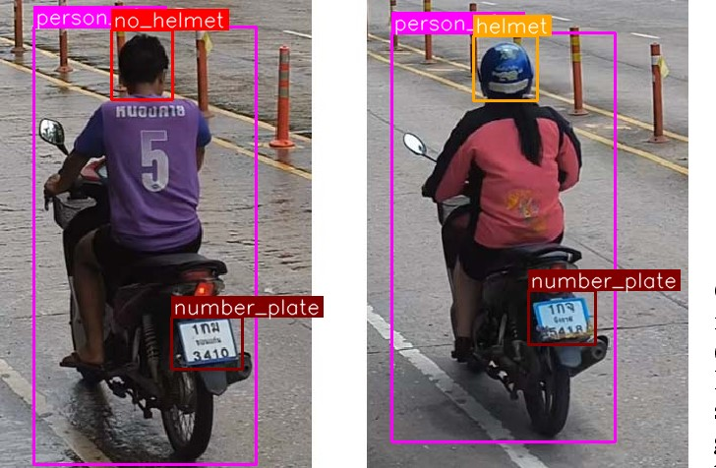

MODULES
OBJECT DETECTION
HELMET CLASSIFICATION
VIOLATION RECORDINGS

Slide 10
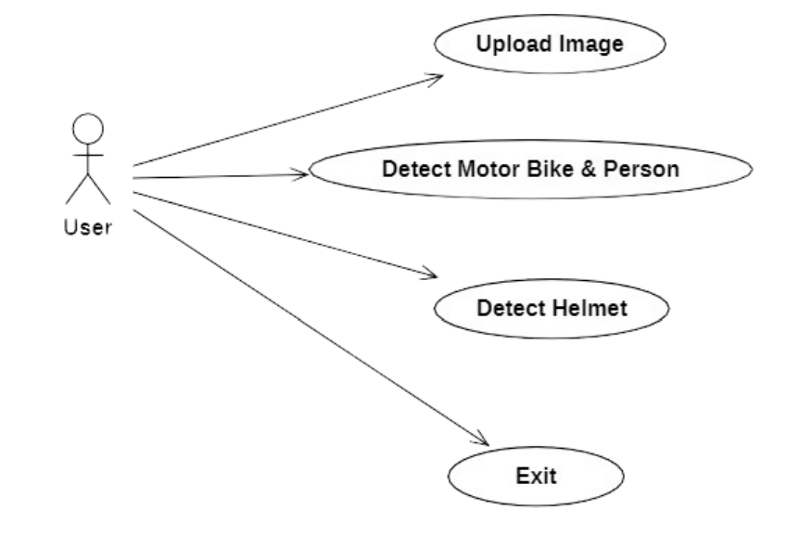
UML DIAGRAM
USE CASE DIAGRAM:

Slide 11
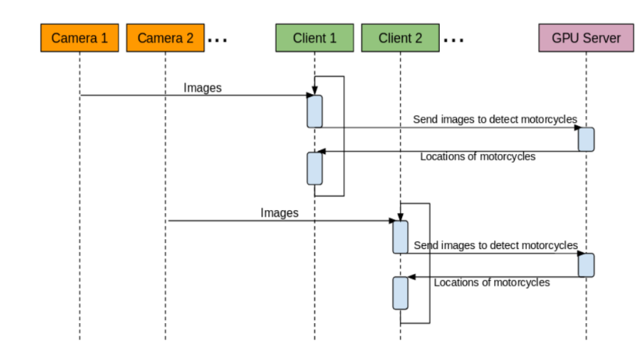
SEQUENCE DIAGRAM:

Slide 12
ADVANTAGES
Increased Enforcement Efficiency
Improved Scalability
Consistency and Objectivity
Data Collection and Analysis
Potential Cost Savings

Slide 13
SYSTEM REQUIREMENTS
Software Requirements:
Operating System: Windows
Coding Language: Python 3.7
Hardware Requirements:
System : Pentium IV 2.4GHz.
Hard Disk : 40GB.
Floppy Driver : 1.44Mb.
Monitor : 15 VGA Colour.
Mouse : Logitech.
Ram: 512 Mb.

Slide 14
INPUTS
IMAGE UPLOAD:
def upload(): #function to upload tweeter profile
global filename
filename = filedialog.askopenfilename(initialdir="bikes")
#messagebox.showinfo ("File Information", "image file loaded")

Slide 15
HELMET DETECTION:
def detectHelmet():
textarea.delete('1.0', END)
if option == 1:
frame = cv.imread(filename)
frame_count =0
blob = cv.dnn.blobFromImage(frame, 1/255, (inpWidth, inpHeight), [0,0,0], 1, crop=False)
net.setInput(blob)
outs = net.forward(getOutputsNames(net))
postprocess(frame, outs,0)
t, _ = net.getPerfProfile()
label = 'Inference time: %.2f ms' % (t * 1000.0 / cv.getTickFrequency())
print(label)
cv.putText(frame, label, (0, 15), cv.FONT_HERSHEY_SIMPLEX, 0.5, (0, 0, 255))
print(label)
else:
messagebox.showinfo("Person & Motor bike not detected in uploaded image", "Person & Motor bike not detected in uploaded image")

Slide 16
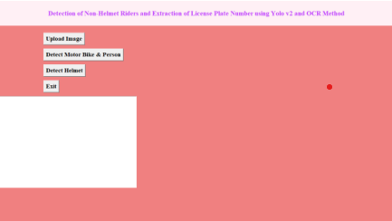
OUTPUT

Slide 17
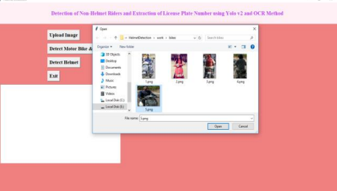

Slide 18
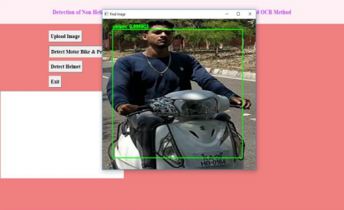

Slide 19
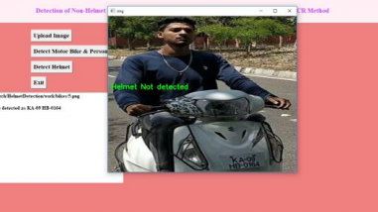

Slide 20
FUTURE SCOPE
Firstly, advancements in artificial intelligence and computer vision technologies are expected to lead to more accurate and reliable detection algorithms. These algorithms will be capable of handling diverse environmental conditions, complex traffic scenarios, and varying helmet designs with improved precision and efficiency.

Slide 21
CONCLUSION
A Non-Helmet Rider Detection system is developed where a video file is taken as input. If the motorcycle rider in the video footage is not wearing helmet while riding the motorcycle, then the license plate number of that motorcycle is extracted and displayed. Object detection principle with YOLO architecture is used for motorcycle, person, helmet and license plate detection. OCR is used for license plate number extraction if rider is not wearing helmet

Slide 22


